Slide 1

Exploratory Data Analysis
G2M Insight for Cab Investment for XYZ Company
October 21st, 2022

Slide 2
Agenda
Executive Summary
Data
Assumptions
EDA
Recommendations

Slide 3
Summary of the project
XYZ, a private US firm, is planning to invest in the cab industry due to remarkable growth in recent years.
As per their Go-to-Market (G2M) strategy they want to understand the market, and as such have asked us to examine market data.
Objective: identify the right company to invest in, using actionable insights derived from provided data.

Slide 4
Data
There are 4 data sets provided, gathered from the time period of 31/01/2016 to 31/12/2018:
Cab_Data.csv – this file includes details of transaction for 2 cab companies
Fields: Transaction ID, date of travel, company, city, km travelled, price charged, cost of trip
Customer_ID.csv – this is a mapping table that contains a unique identifier which links the customer’s demographic details
Fields : City, population, users
Transaction_ID.csv – this is a mapping table that contains transaction to customer mapping and payment mode
Fields : Id, Gender, Age, Income
City.csv – this file contains list of US cities, their population and number of cab users
Fields : transaction ID, customer ID, payment mode

Slide 5
Assumptions
As KM travelled increases, there is a lot of variation in price charged. This may indicate unseen additional charges for longer distances, or the existence of a base fee.

Slide 6
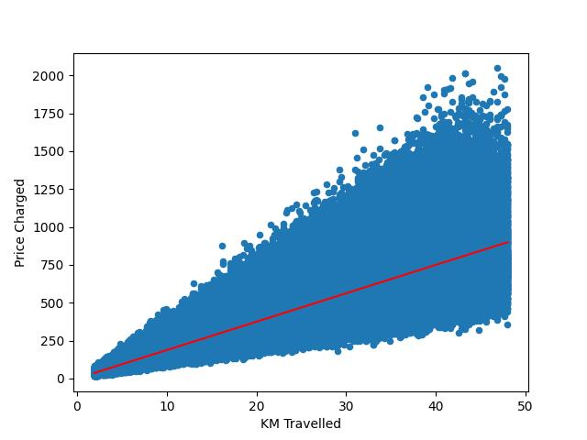
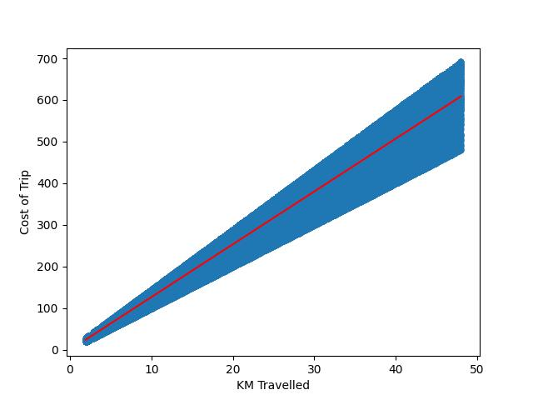
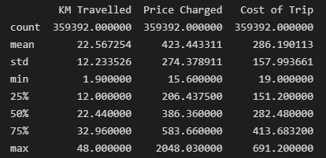
Price Charged and Cost of trip variance
Figure 3
Figure 1
Figure 2
Company | Total number of trips | Total Cost of trips | Total Price Charged | Price charged per trip
Pink Cab | 84,711 | $21,020,923 | $26,328,251.33 | $310.80
Yellow Cab | 274,681 | $81,833,514 | $125,853,887.20 | $458.181
Figure 4
As KM travelled increases, so does the variance in the price charged by the companies, as seen in figure 1,
and further reinforced with the std values seen in figure 3.

Slide 7
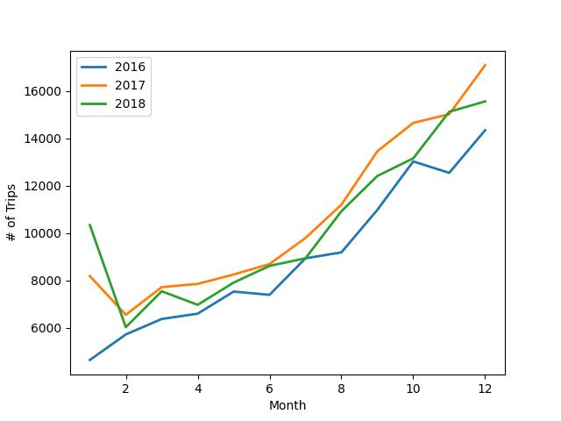
Seasonal Changes in Customer Activity
As seen in Figure 1, there is a yearly growth in number of customers.
Along with this we can see a trend in seasonal activity where the number of
Customers drops shortly into the new year, then increases the later into the
year it gets, with significant increases starting to occur around the month 6
mark.
These trends are most likely due to things like drops in temperature and an
Increase in precipitation (Snow and Rain).
Figure 1

Slide 8
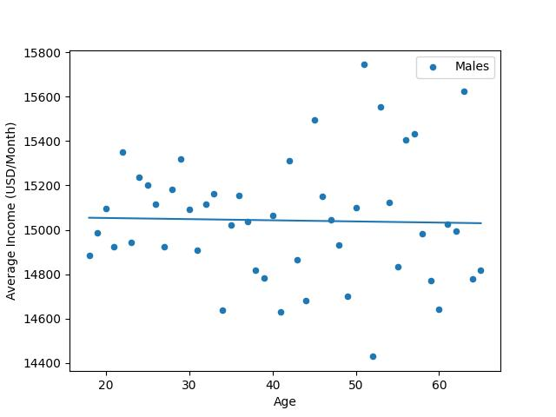
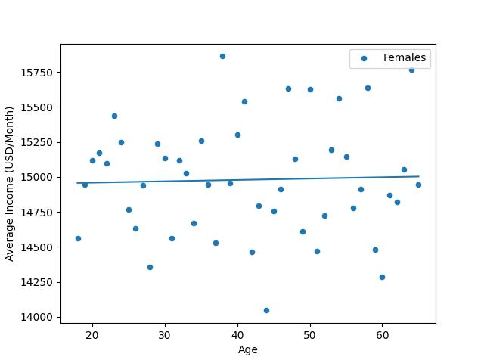
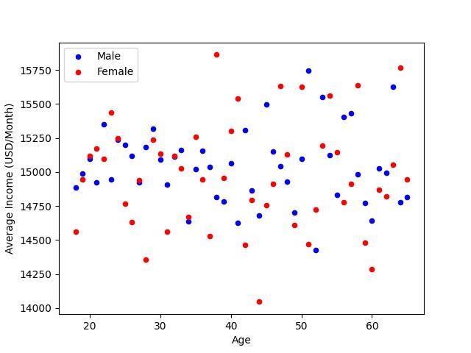
Customer Demographics
Gender | Number of Customers
Female | 22609
Male | 26562
Figure 1
Figure 2
Figures 1-3 show the distribution of Average incomes among the different
Age groups in customers of both genders. The data shows higher average
Income for younger males and older females.
Figure 3

Slide 9
City Data
Below is the breakdown for the number of transactions, and the prices charged , for both cab companies, in each city
Yellow Cab City Data
Pink Cab City Data
City | Total Number of Transactions | Total Price Charged | Total Trip Price
ATLANTA GA | 5795 | 125853887.2 | 81833514.02
AUSTIN TX | 3028 | 125853887.2 | 81833514.02
BOSTON MA | 24506 | 125853887.2 | 81833514.02
CHICAGO IL | 47264 | 125853887.2 | 81833514.02
DALLAS TX | 5637 | 125853887.2 | 81833514.02
DENVER CO | 2431 | 125853887.2 | 81833514.02
LOS ANGELES CA | 28168 | 125853887.2 | 81833514.02
MIAMI FL | 4452 | 125853887.2 | 81833514.02
NASHVILLE TN | 1169 | 125853887.2 | 81833514.02
NEW YORK NY | 85918 | 125853887.2 | 81833514.02
ORANGE COUNTY | 2469 | 125853887.2 | 81833514.02
PHOENIX AZ | 1200 | 125853887.2 | 81833514.02
PITTSBURGH PA | 631 | 125853887.2 | 81833514.02
SACRAMENTO CA | 1033 | 125853887.2 | 81833514.02
SAN DIEGO CA | 9816 | 125853887.2 | 81833514.02
SEATTLE WA | 5265 | 125853887.2 | 81833514.02
SILICON VALLEY | 4722 | 125853887.2 | 81833514.02
TUCSON AZ | 1132 | 125853887.2 | 81833514.02
WASHINGTON DC | 40045 | 125853887.2 | 81833514.02
Total | 274681 | 2391223857 | 1554836766
City | Total Number of Transactions | Total Price Charged | Total Trip Price
ATLANTA GA | 1762 | 26328251.33 | 21020923.01
AUSTIN TX | 1868 | 26328251.33 | 21020923.01
BOSTON MA | 5186 | 26328251.33 | 21020923.01
CHICAGO IL | 9361 | 26328251.33 | 21020923.01
DALLAS TX | 1380 | 26328251.33 | 21020923.01
DENVER CO | 1394 | 26328251.33 | 21020923.01
LOS ANGELES CA | 19865 | 26328251.33 | 21020923.01
MIAMI FL | 2002 | 26328251.33 | 21020923.01
NASHVILLE TN | 1841 | 26328251.33 | 21020923.01
NEW YORK NY | 13967 | 26328251.33 | 21020923.01
ORANGE COUNTY | 1513 | 26328251.33 | 21020923.01
PHOENIX AZ | 864 | 26328251.33 | 21020923.01
PITTSBURGH PA | 682 | 26328251.33 | 21020923.01
SACRAMENTO CA | 1334 | 26328251.33 | 21020923.01
SAN DIEGO CA | 10672 | 26328251.33 | 21020923.01
SEATTLE WA | 2732 | 26328251.33 | 21020923.01
SILICON VALLEY | 3797 | 26328251.33 | 21020923.01
TUCSON AZ | 799 | 26328251.33 | 21020923.01
WASHINGTON DC | 3692 | 26328251.33 | 21020923.01
Total | 84711 | 500236775.3 | 399397537.2

Slide 10
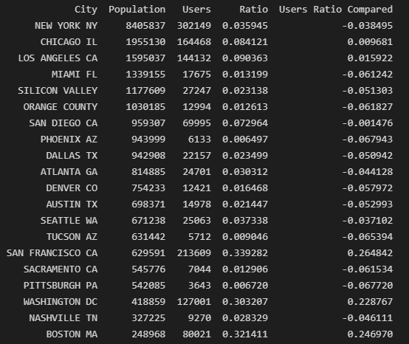
City Data Cont.
Figure 1 shows the difference in stats between Yellow Cab and Pink Cab (Yellow – Pink)
A negative number indicates that Pink outperformed Yellow
Figure 2 shows the total population vs. number of users for each city, as well as the ratio of users-to-population, and each cities ratio compared to the average
City | Total Number of Transactions | Total Price Charged | Total Trip Price
ATLANTA GA | 4033 | 99525635.86 | 60812591.01
AUSTIN TX | 1160 | 99525635.86 | 60812591.01
BOSTON MA | 19320 | 99525635.86 | 60812591.01
CHICAGO IL | 37903 | 99525635.86 | 60812591.01
DALLAS TX | 4257 | 99525635.86 | 60812591.01
DENVER CO | 1037 | 99525635.86 | 60812591.01
LOS ANGELES CA | 8303 | 99525635.86 | 60812591.01
MIAMI FL | 2450 | 99525635.86 | 60812591.01
NASHVILLE TN | -672 | 99525635.86 | 60812591.01
NEW YORK NY | 71951 | 99525635.86 | 60812591.01
ORANGE COUNTY | 956 | 99525635.86 | 60812591.01
PHOENIX AZ | 336 | 99525635.86 | 60812591.01
PITTSBURGH PA | -51 | 99525635.86 | 60812591.01
SACRAMENTO CA | -301 | 99525635.86 | 60812591.01
SAN DIEGO CA | -856 | 99525635.86 | 60812591.01
SEATTLE WA | 2533 | 99525635.86 | 60812591.01
SILICON VALLEY | 925 | 99525635.86 | 60812591.01
TUCSON AZ | 333 | 99525635.86 | 60812591.01
WASHINGTON DC | 36353 | 99525635.86 | 60812591.01
Total Difference | 189970 | 1890987081 | 1155439229
Figure 2
Figure 1

Slide 11
Recommendations
Feasibility: The yearly growth is evident in the data, with each year in the industry outperforming the last. With this growth in mind, it is important to start investing as soon as possible to see long-term gains
Time of year to start investing: The best time period to enter the market is before the beginning of June. After the 6th month the number of customers begins to sharply climb. This makes it the ideal time frame to start investing.
Cities to start in: The cities performing the best are Washington, New York, Chicago and Boston. These cities have the highest number of users, and of these cities all but New York show a positive value in their Users Ratio Compared, the value which looks at how that city’s Users-to-Population ratio compares to the average of all the cities.
Which company to invest in: The Pink Cab Company both shows a higher cost of trip/price charged when compared to the Yellow Cab Company. Also, with no difference in data start date between the two companies, the Pink Cab Company has a much greater number of users. These two combined yield a much higher revenue compared to the Yellow Cab Company.

Slide 12

Thank You!

